Slide 1
Python Numpy
pip install numpy
print(np.__version__)

Slide 2
Numpy
Numpy is a Python Package which stands for “Numerical Python”.
This was created in 2005 by Travis Oliphant.
Using NumPy we can perform the following functionalities.
1. Mathematical and Logical calculations on Array.
2.Fourier transforms and routines for shape manipulation.
3.It has built in functions for Liner Algebra random number generation.
4.User for scientific calculations.
5.It is faster than Python List.
6.It is fast because it is associated with c Programming

Slide 3
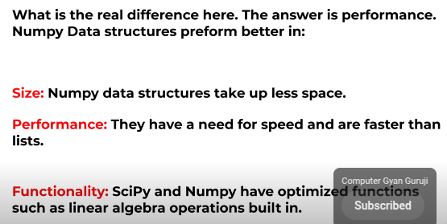
Numpy Array Vs Python List
Numpy Array Vs Python List

Slide 4
Numpy
. NumPy is often callend as an alternate for MatLab (a programming platform designed specifically for engineers and scientists for Data Analysis, Developing Algorithms, Create Models and applications etc).
. Numpy is used with packages link Scipy(Scientific python) and Mat-Plotlib (Plotting Library) and this makes it capable to replace MatLab.
1. 1 Dimensional Array id referred to as Vector.
2. 2 Dimensional Array is referred to as Matrix.
3. 3 Dimensional Array is referred to as Tensor

Slide 5
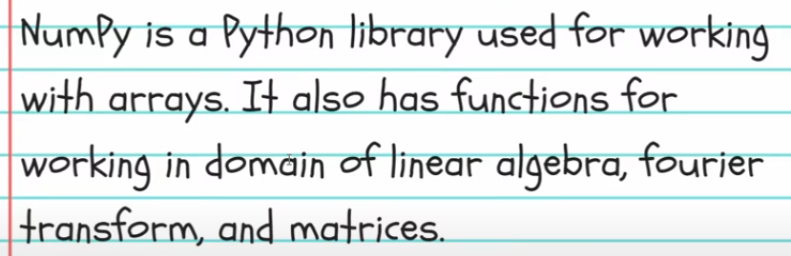
What is Numpy

Slide 6
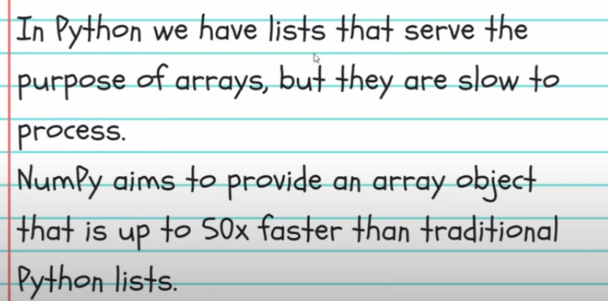
Why use Numpy

Slide 7
Creating Arrays with Dimensions
NumPy is used to work with arrays. The array object in NumPy is called ndarray.
We can create a NumPy ndarray object by using the array() function.

Slide 8
Dimensions in Arrays
A dimension in arrays is one level of array depth (nested arrays).

Slide 9
0-D Arrays
0-D arrays, or Scalars, are the elements in an array. Each value in an array is a 0-D array.
import numpy as np
arr = np.array(42)
print(arr)

Slide 10
1-D array.
An array that has 0-D arrays as its elements is called uni-dimensional or 1-D array.
These are the most common and basic arrays.
import numpy as np
arr = np.array([1, 2, 3, 4, 5])
print(arr)

Slide 11
2-D Arrays
An array that has 1-D arrays as its elements is called a 2-D array.
These are often used to represent matrix or 2nd order tensors.
import numpy as np
arr = np.array([[1, 2, 3], [4, 5, 6]])
print(arr)

Slide 12
3-D arrays
An array that has 2-D arrays (matrices) as its elements is called 3-D array.
These are often used to represent a 3rd order tensor.
import numpy as np
arr = np.array([[[1, 2, 3], [4, 5, 6]], [[1, 2, 3], [4, 5, 6]]])
print(arr)

Slide 13
5 dimensions
import numpy as np
arr = np.array([1, 2, 3, 4], ndmin=6)
print(arr)
print('number of dimensions :', arr.ndim)

Slide 14
NumPy - Indexing, Accessing Array Element
Array indexing is the same as accessing an array element.
start with 0 , Second 1

Slide 15
Slicing arrays
Slicing in python means taking elements from one given index to another given index.
We pass slice instead of index like this: [start:end].
We can also define the step, like this: [start:end:step].

Slide 16
NumPy Data Types
Data Types in Python
strings - used to represent text data, the text is given under quote marks. e.g. "ABCD"
integer - used to represent integer numbers. e.g. -1, -2, -3
float - used to represent real numbers. e.g. 1.2, 42.42
boolean - used to represent True or False.
complex - used to represent complex numbers. e.g. 1.0 + 2.0j, 1.5 + 2.5j

Slide 17
Data Types in NumPy
i - integer
b - boolean
u - unsigned integer
f - float
c - complex float
m - timedelta
M - datetime
O - object
S - string
U - unicode string
V - fixed chunk of memory for other type ( void )

Slide 18
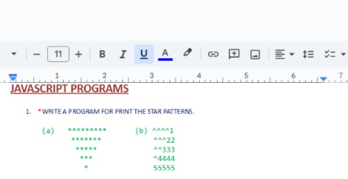

NumPy Array Copy vs View
NumPy Array Shape

Slide 19
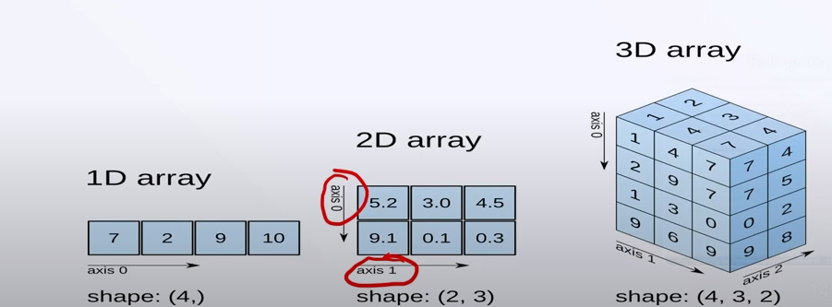

Slide 20
write A program to extract ODD index value from an array[ ] in array A [ ] without decimal place and extract even index value from an array [ ] in array B [ ] without decimal place and sum of two array elements and saves sum in third array result [ ]. then print the third array result []. javascript

Slide 21
write a function to find the first and second largest element in an array and substract 1 from then and if there is duplicate value found also remove that and return mutiplication of resulting elements .javascript
write a function to input an integer n and print the sum of all its even digits and all its odd digits separately. then given integer is "23587"even digits are 2 & 8 and their sum is 10, adn odd digits are 3,5,& 7 and their sum is 15. and multiply the resultant value 10x15=150 and check this number is prime or not

